Slide 1
PRI: Arizona School Board Member Conference Increasing Student Achievement Brandon Crowe, Great Hearts December 5, 2023

Slide 2
Who We Are
Great Hearts is a not-for-profit charter school organization dedicated to the public good, founded 21 years ago.
Our co-founders chose the name Great Hearts because our first commitment is to ensure that students have great hearts –
deep human connection with one another and their moral purpose: virtue.
That emphasis permeates all aspects of the organization – our leadership expectations, faculty development, and student formation.
What We Do
We believe, with Plato, that the highest aim of education is to become good intellectually and morally—thinking deeply, loving noble things, and living well together.
To that end, Great Hearts delivers a time-tested education that cultivates the hearts and minds of students through the pursuit of Truth, Goodness, and Beauty. Our students become moral human beings, rigorous thinkers, and exemplary citizens.
To cultivate the minds and hearts of students through the pursuit of Truth, Goodness, and Beauty.

Slide 3
Great Hearts History
Great Hearts Academies restores the promise of American K-12 education:
'A' rated in established regions of Arizona and Texas
Highest performing charter network/district and highest scoring elementary school in Arizona in 21-22
Demonstrated capacity to serve all students, and to satisfy parents
An excellent track record of college preparation
The first classical charter network in America (est. 2002) and leader of the classical education movement
The largest brick-and-mortar classical provider and one of the largest, fastest-growing and best-performing charter networks in the nation
A non-profit at all levels, incorporated for the public good
Fulfilling the promise envisioned by America’s founders of “diffusing knowledge in close consort with virtue” Samuel Adams’ Letter to James Warren, February 12, 1779

Slide 4
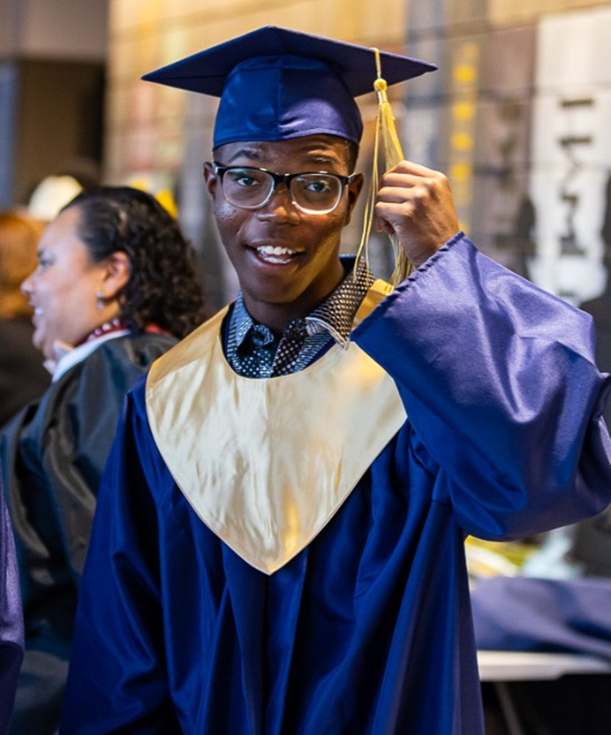
Academic Achievement
1. Curriculum
3. Student Outcomes
2. Instructional Techniques
3. Student Outcomes
4. School Culture

Slide 5
1. Curriculum
Content rich
ELA/Math
History, Science, Fine Arts, Language
Alignment – Horizontal and Vertical
3. Student Outcomes

Slide 6
2. Instructional Techniques
NOT “outcomes” only
Memorization
“Socratic Method”
READ!
3. Student Outcomes

Slide 7
3. Student Outcomes
Formative and Summative Assessments
Internal Standards and State Standards
Efficient Scrutiny and Intervention
Avoid “Analysis Paralysis”
3. Student Outcomes

Slide 8
4. School Culture
Meaningful Homework and Completion
Learning vs. Grades
Kipling’s “If”
Faculty: Role Models
3. Student Outcomes

Slide 9
To cultivate the minds and hearts of students through the pursuit of Truth, Goodness, and Beauty.

