Slide 2
Ethnic Studies–SMUHSD
Summer 2023: ETHS faculty tasked with compiling “curriculum guide”
March 2023: Superintendent responds by holding a study session
Board social studies update March 2021: bring ethnic studies lens into other subjects
Jan 2023: Article published about Samia Shoman–her role in first draft of ESMC. prompted ACES email campaign to board
June 2023: Contract with Acosta not renewed

Slide 3
Board Social Studies Update: March 2021

Slide 4
Board Social Studies Update: March 2021

Slide 5
Gwen Lei from San Mateo County Office of Ed:

Slide 7
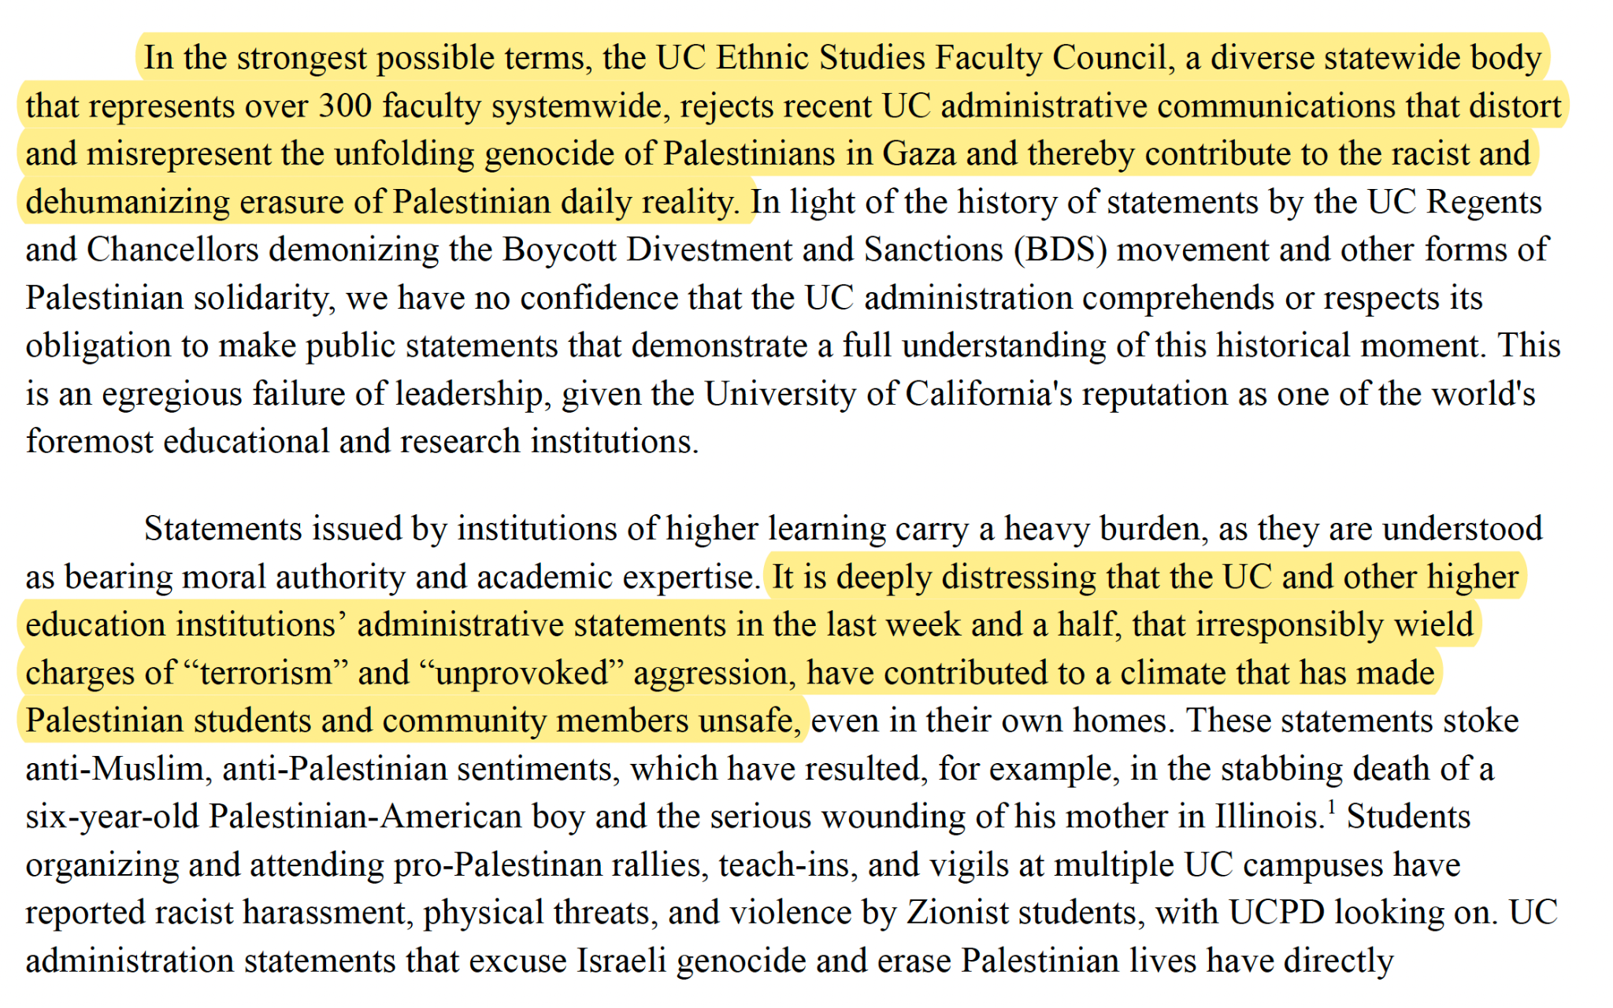

Slide 8
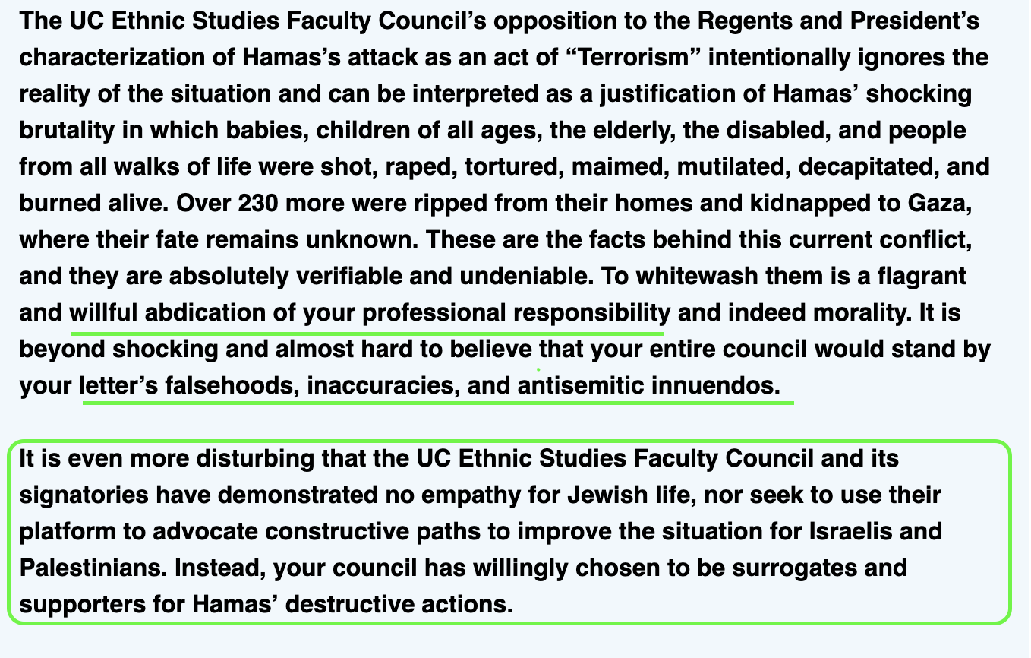
Jay Sures (UC Board of Regents) response:

Slide 9
Jay Sures (UC Board of Regents) response:

Slide 10
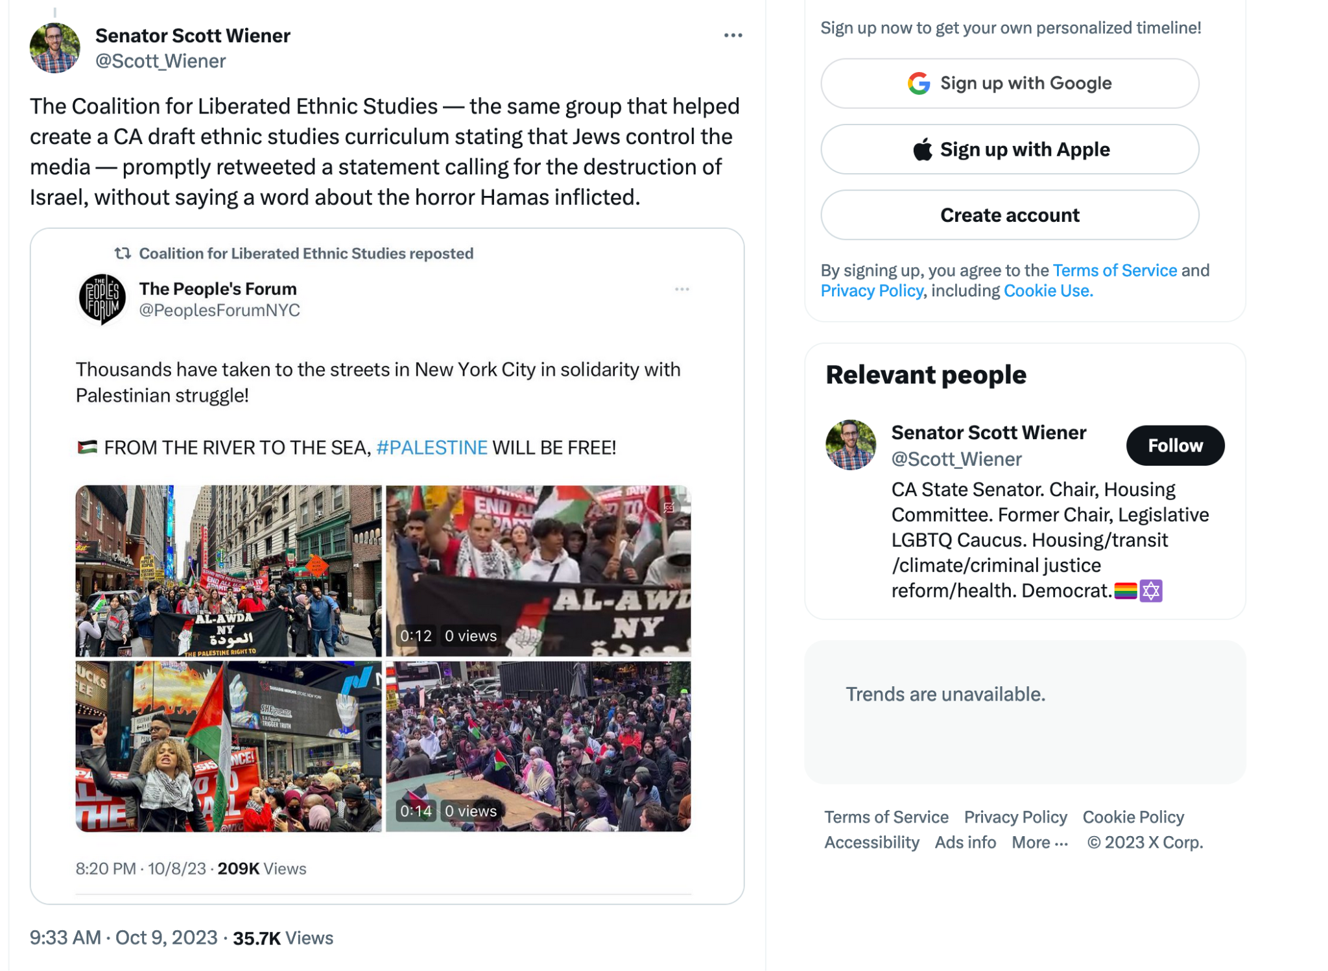

Slide 12
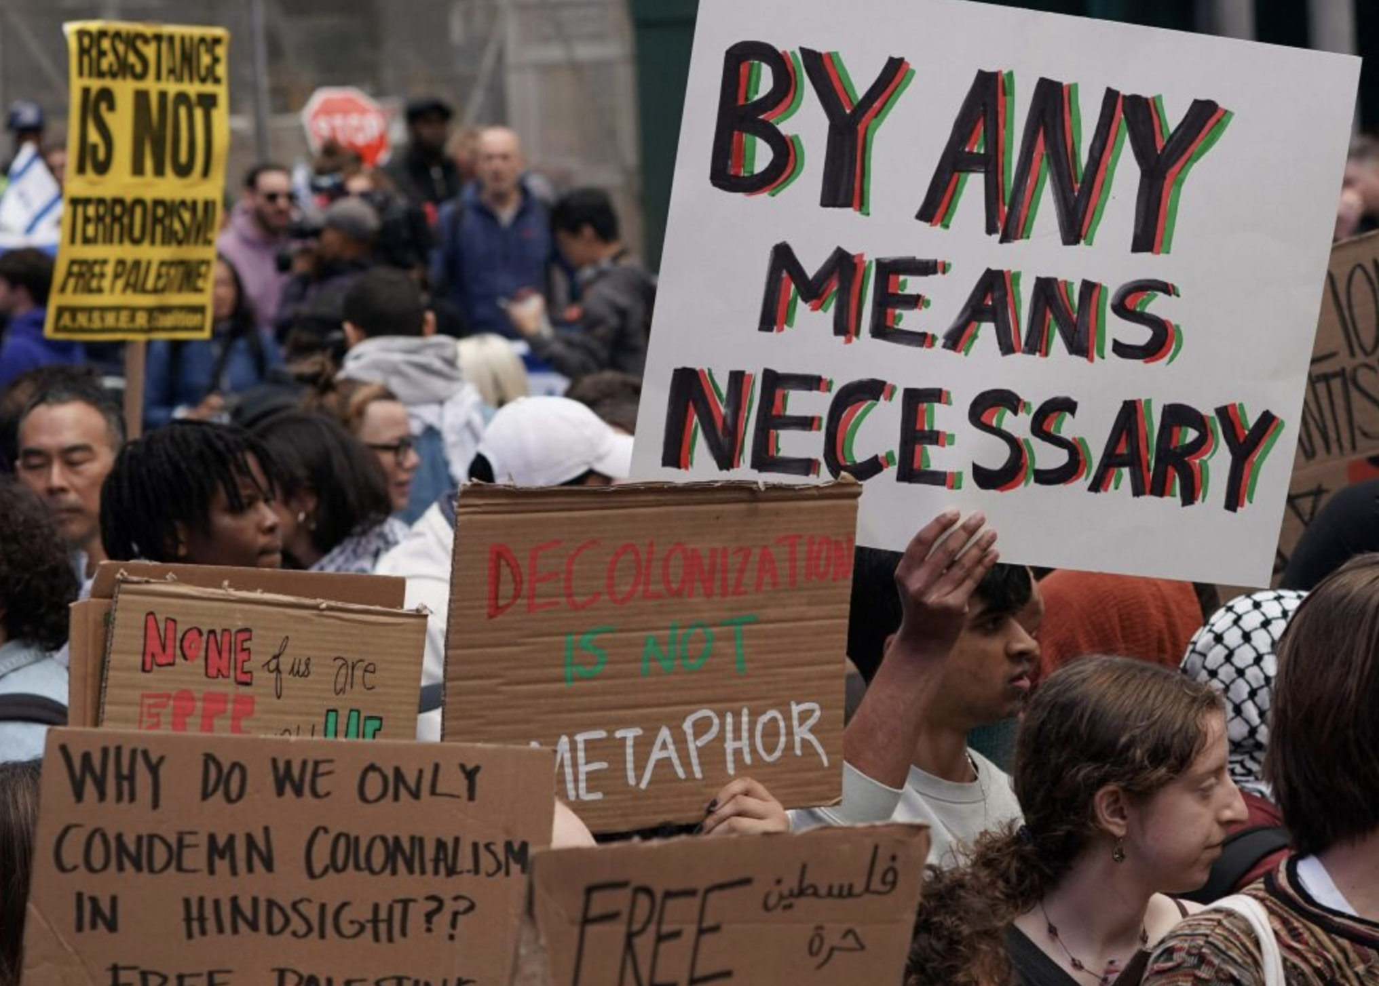
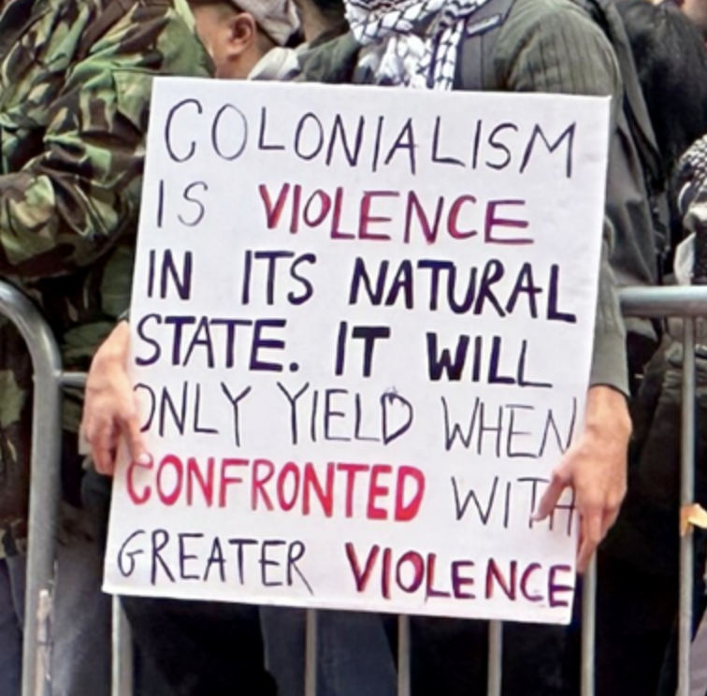

Slide 13
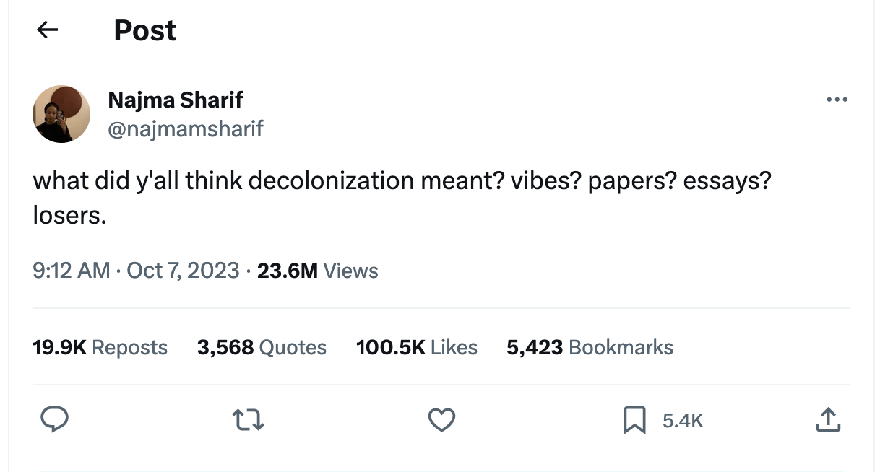
Writer: “dedicated to telling stories that amplify marginalized voices and is interested in creating challenging work that complicates how we think about and navigate the world.

