Slide 1
ETHNIC STUDIES
IN CALIFORNIA
WHAT YOU’VE BEEN TOLD
IS NOT WHAT YOU’RE GETTING

Slide 2
ETHNIC STUDIES TIMELINE
DATE
ACTIVITY
September 13, 2016
AB 2016 (Alejo) signed into law, directing the SBE to develop an Ethnic Studies Model Curriculum (ESMC)
July 11-18, 2018
State Board of Education (SBE) approved guidelines for Model Curriculum.
June 15 – August 15, 2019
Initial draft of ESMC posted for public feedback. Most controversial curriculum in CA history: 70k+ comments.
October 2019
Initial ESMC draft writers dismissed, deadline extended to re-write the curriculum. Instructions to remove bias, make appropriate for K-12.
March 18, 2021
After three drafts and two public comment periods, SBE approved ESMC.
October 8, 2021
AB101 signed into law, requiring at least 1 semester Ethnic Studies-focused class for graduation as of 2030.

Slide 3
WHAT IS A MODEL CURRICULUM?
According to the California Department of Education FAQ…
https://www.cde.ca.gov/ci/cr/cf/esmcfaqs.asp
A model curriculum is a guidance document that provides support to teachers and administrators in developing courses and/or instructional content in a specific topic area.
It is not a complete classroom curriculum or instructional materials; it is intended as a resource.
A model curriculum is similar to a curriculum framework, but with a specific focus.

Slide 4
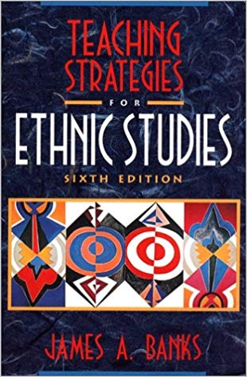
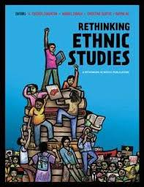
ETHNIC STUDIES IN EDUCATION
CONSTRUCTIVE
ETHNIC STUDIES
LIBERATED
ETHNIC STUDIES

Slide 5
FOUNDATION OF
CONSTRUCTIVE ETHNIC STUDIES
A well done ES curriculum should
empower students to confront racism and other discrimination by coming together in productive ways, allowing them to share common ground and going beyond past and current stereotypes.
Ethnic Studies curricula should aim to foster among students “an appreciation for the contributions of multiple cultures.”
Luis Alejo, AB2016 legislation

Slide 6
WHAT IS LIBERATED ETHNIC STUDIES?
“critique empire in history and its relationship to white supremacy, racism, patriarchy, cisheteropatriarchy, capitalism, …and other forms of power and oppression”
Liberated Ethnic Studies TO DO list:
create victims
connect victims to each other
use militant resistance as means to social change

Slide 7
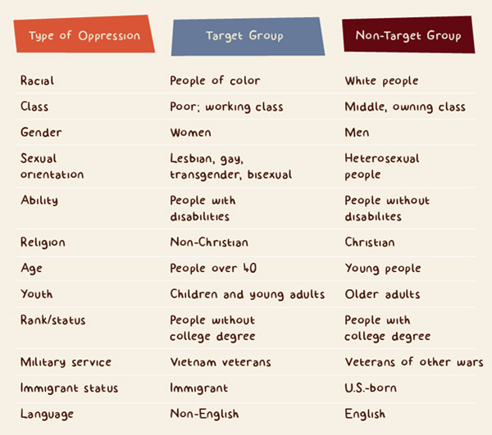
VICTIMS

Slide 8
INTERSECTIONALITY
student
non-binary
Black American
non-Christian
Asian American
disability
BINGO!!
female
Native American
first generation

Slide 9
REVOLUTION AS MEANS OF CHANGE
154 “IMPORTANT HISTORICAL FIGURES
AMONG PEOPLE of COLOR”
in the drafts of ESMC
OMITTED: Dr. Martin Luther King Jr., John Lewis, other peaceful leaders working as agents of change “within the system” (Civil Rights leaders described as “passive” and “docile”)
Dr. Clarence Jones, speech writer and advisor to MLK, regarding the ESMC drafts:
“I write in a plea for moral reasoning and decency, and for a respect for truth and accuracy…"

Slide 10
MILITANT ROLE MODELS
Consistent choice of Marxist militants
Assata Shakur: member of Black Liberation Army – organization engaged in armed struggle against the US Government through tactics such as robbing banks and killing police officers. Assata was convicted of first degree murder of a police officer.
Lolita Lebrón: led an armed group of Puerto Rican nationalists in an attack on the US House of Representatives in 1954. They fired 30 bullets from a spectator’s gallery, wounding five congressmen.
Yuri Kochiyama: Maoist advocate, admirer of Osama bin Laden and Al Qaeda. (Role model for subject of Japanese internment reparations, rather than Congressmen Norman Mineta and Robert and Doris Matsui.)
LESMC Guiding Principle #6: “Connect ourselves to past and contemporary resistance movements that struggle for social justice on the global and local levels to ensure a truer democracy.”

Slide 11
WHO ARE THE OPPRESSORS?
Teachers must be “grounded in the correct politics to educate students.” in order to tackle the “white colonialist regime” of the US as a “parasitic system.”
Themes: colonialism, hegemony, systems of power,
anti-capitalism, resistance

Slide 12
EXAMPLES FROM THE CLASSROOM
Power and Privilege Definitions and Overview
“Some groups are socially allowed to be more powerful (teachers, police, parents) and their accumulation and uneven distribution of power comes at the expense of other groups.”
Colonization and Hegemony Intro
Hegemony - school “exerts control and dominance, this is done through force or ideology.”
Pedagogy of the Oppressed Reading
“What role does school play in making us act oppressively or want to be oppressors?”
“Who created this hegemonic norm of education?”
“Colonization created the hegemonic norms. The people in power created the standards, rules, what is ‘normal.’ Think and challenge hegemonic norms created by colonization.”

Slide 13
“Symbols of dominant American culture ”
Symbols of dominant American culture include the U.S. flag, the Liberty Bell, the Statue of Liberty, Mount Rushmore, the White House, the national anthem, and the bald eagle. For the most part, these symbols highlight the history of the United States that generally revolves around citizens with dominant social identities (i.e., men, White people, wealthy people, etc.).
Dominant American Culture worksheet R4
San Mateo High School, Introduction to Ethnic Studies

Slide 14
IN THEIR OWN WORDS
“Zionism is a nationalist, colonial ideology that, from the late 19th century on, has called for the creation and expansion of Israel as a Jewish state in historic Palestine by any means necessary.”
“Teaching the truth about Palestine is also a liberatory act, for teachers and for students. It’s a political decision. But, as much as possible, you want to be strategic. The goal is for your anti-racist teaching to be sustainable, and to be part of a larger movement.”

Slide 15
Bill Honig, former California State Superintendent:
…“liberated” ethnic studies is part of a political movement centered on race consciousness that seems intent on alienating youth from our institutions. Presenting non-whites as victims and whites, individually and collectively through institutions, as oppressors, liberationists hope to create activists who will radically transform their schools, their communities and our nation.
Most distressingly, liberationists’ emphasis on victimization narrows students’ perspectives and deprives students of the agency they need to reach their fullest potential.
- EdSource, June 26, 2022

Slide 16
WHAT IS A CONSTRUCTIVE CURRICULUM?
A Constructive ES survey course provides an overview of the experiences and contributions of ethnic groups in the United States that have been marginalized or targets of hate crimes. The course provides information that honestly addresses the racism and discrimination experienced by previous generations, and that many still face, acknowledging how obstacles were and can still be overcome.

Slide 17
WHAT IS A CONSTRUCTIVE CURRICULUM?
In additional to addressing racism honestly, Constructive Ethnic Studies course goals include:
Building mutual respect, self-confidence, awareness, intergroup understanding and empathy
Increasing engagement by enabling students to see themselves in the curriculum
Presenting a range of perspectives and approaches to bringing about change

Slide 18
AB101
Governor Gavin Newsom signs CA AB 101, making an Ethnic Studies course a graduation requirement for all public high schools.
Guardrails include:
legislative intent that school districts not adopt the content that was rejected from the Model Curriculum’s early drafts
two-step community review of the curriculum before it is adopted by a district.

Slide 19
RECOMMENDATIONS
Encourage a Constructive Ethnic Studies curriculum
Transparency is key
Be careful of teacher training
Encourage the district to involve multiple viewpoints when creating course content
Consider making it a senior level or 1 semester course

Slide 20
CONTACT ME
Lia Rensin
lia@calethstudies.org
More info on Ethnic Studies:
www.calethstudies.org

