Slide 1
Where’s the Money? (and how do we get our Super to use it to improve education)
Todd Maddison
Director of Research, Transparent California
http://transparentcalifornia.com
November 29th, 2023

Slide 2
Where’s the Money?
$129.2 Billion

Slide 3
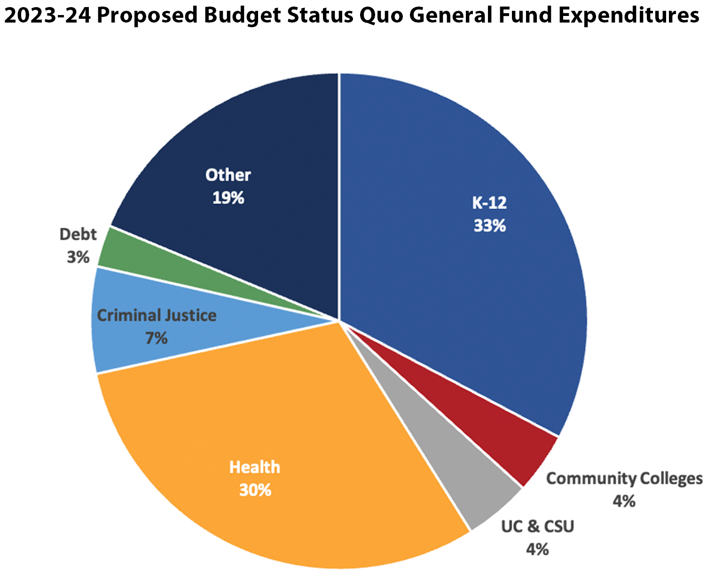
Where’s the Money?

Slide 4
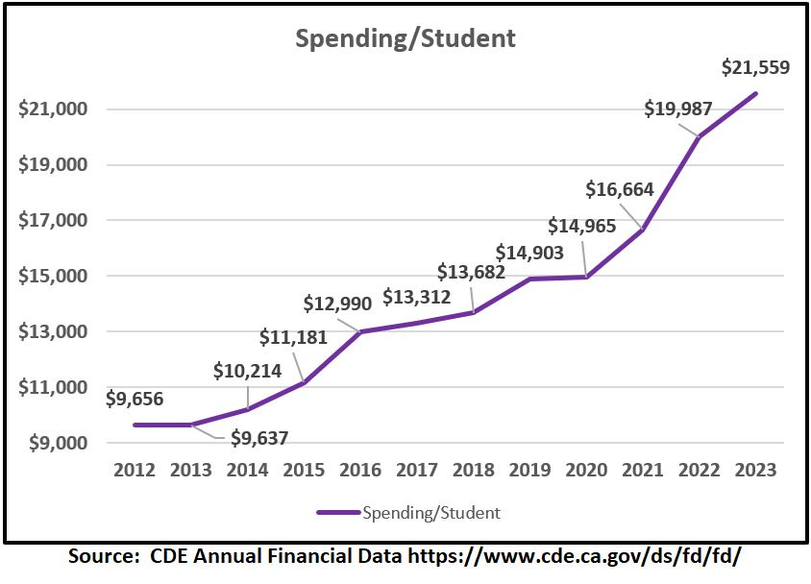
Where’s the Money?
Statewide per student
spending has risen from $9,656 in 2012 to
$21,559 in 2023.
Increase rate 7.5% PER YEAR, about 2 ½ times inflation.

Slide 5
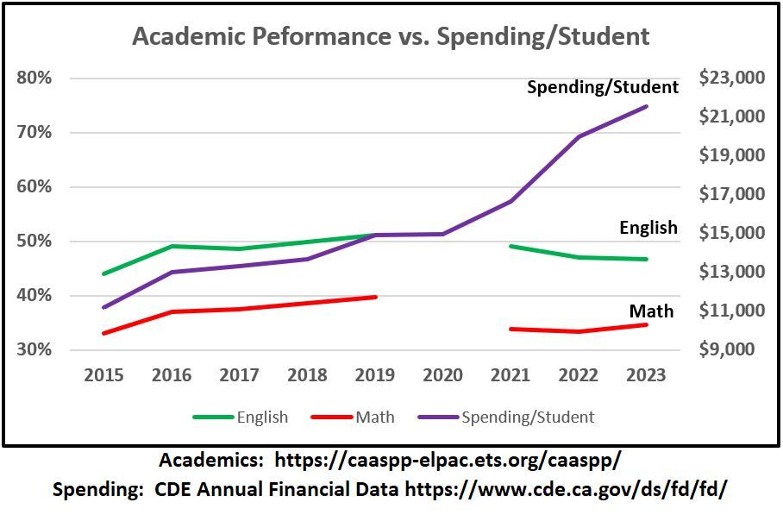
Where’s the Money?
Spending goes up….
… while academic performance goes down…
47% proficient in English, 35% proficient in Math (2023)

Slide 6
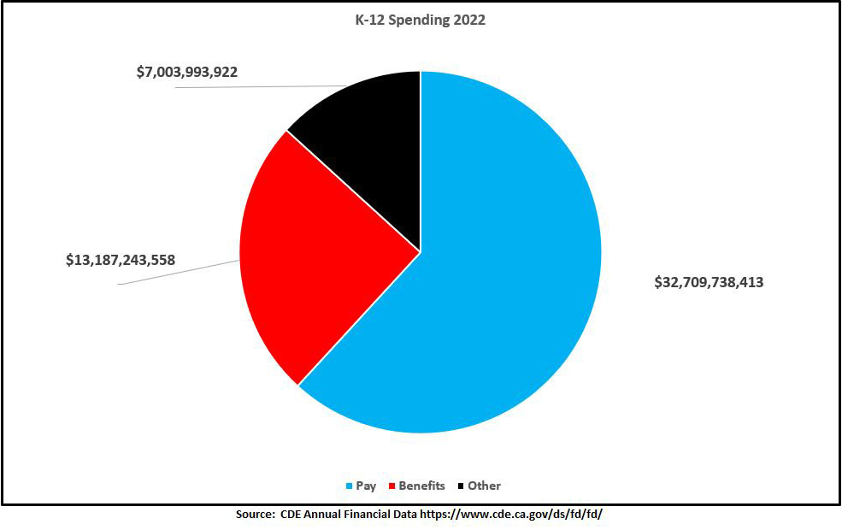
Where’s the Money?
86.76% of all spending went to labor costs – pay and benefits for employees (2022)

Slide 7
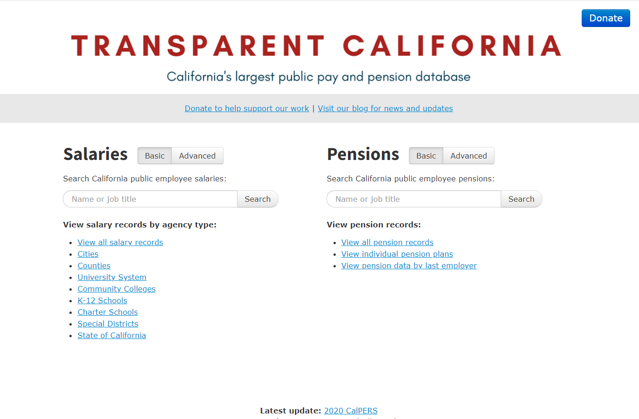
Where’s the Money?
http://transparentcalifornia.com

Slide 8
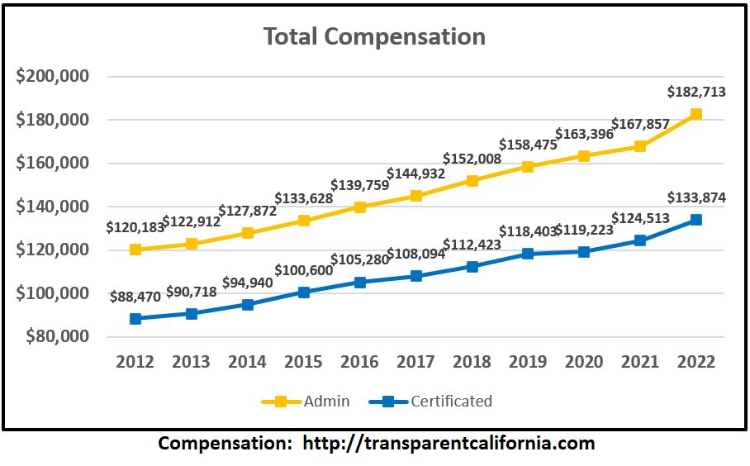
Where’s the Money?
2022 Median Total Compensation: Administrators: $182,713
Certificated: $133,874

Slide 9
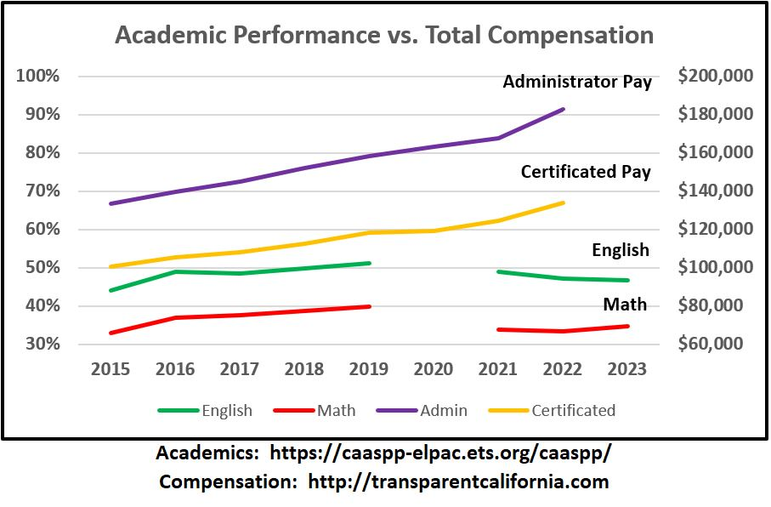
Where’s the Money?
Pay and Benefits: Up
Academic Performance:
Down

Slide 10
What Can We Do?
What can a school board do?

Slide 11
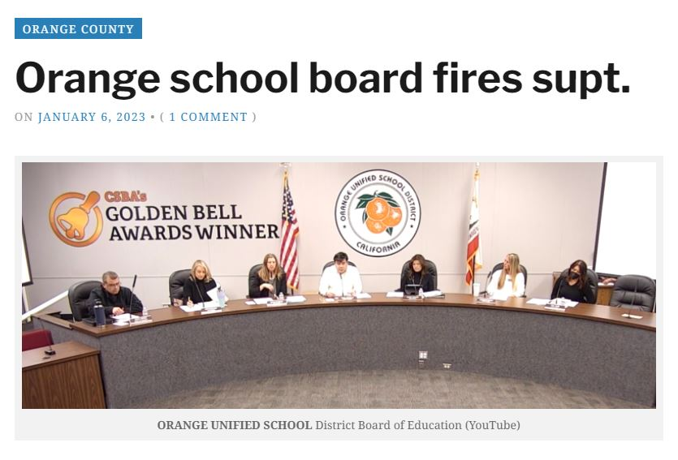
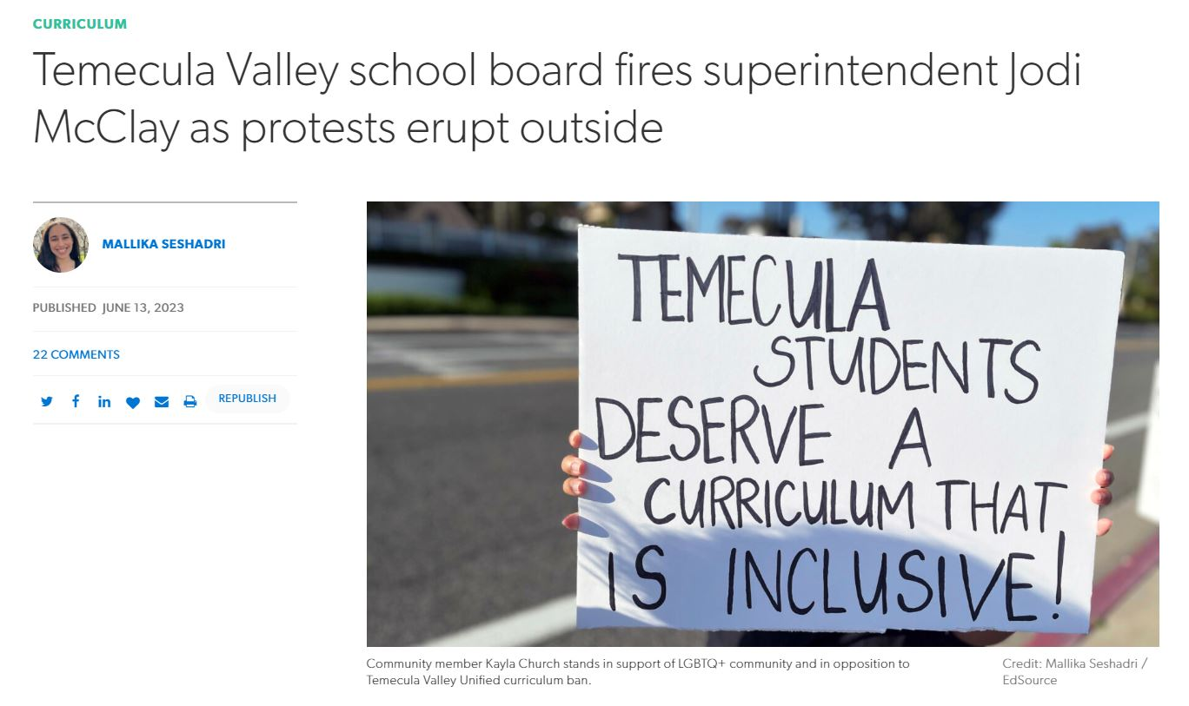
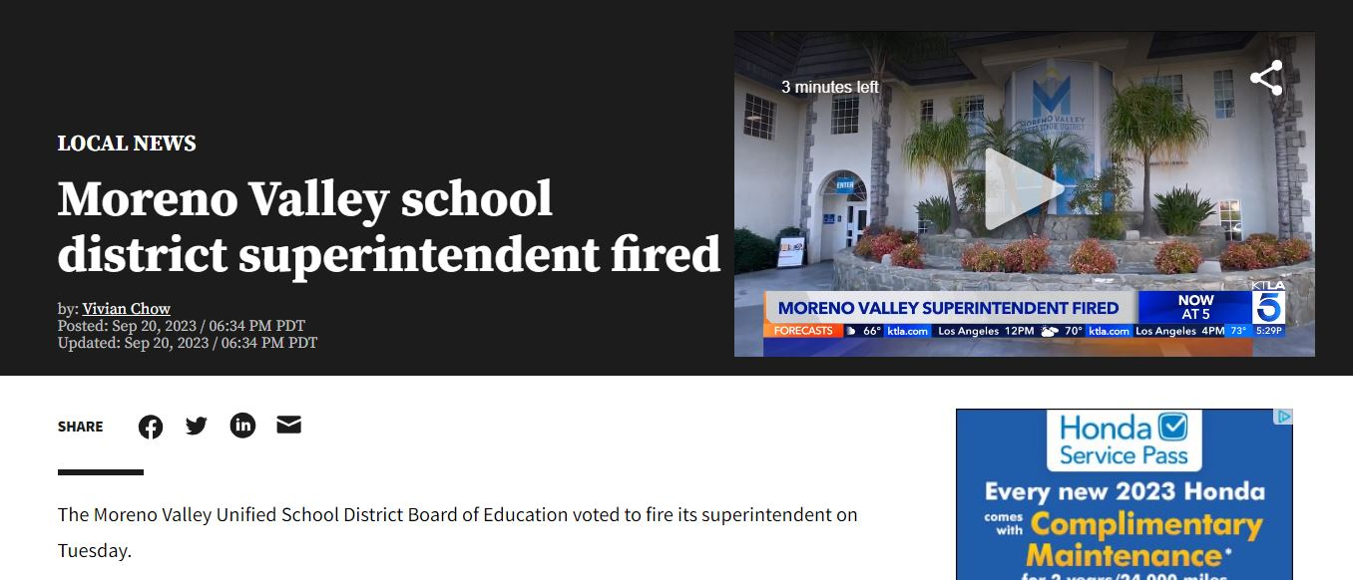
What Can We Do?

Slide 12
What Can We Do?
Win!

Slide 13
What Can We Do?
Win!
Win!

Slide 14
What Can We Do?
Win!
Win!
Win!

Slide 15
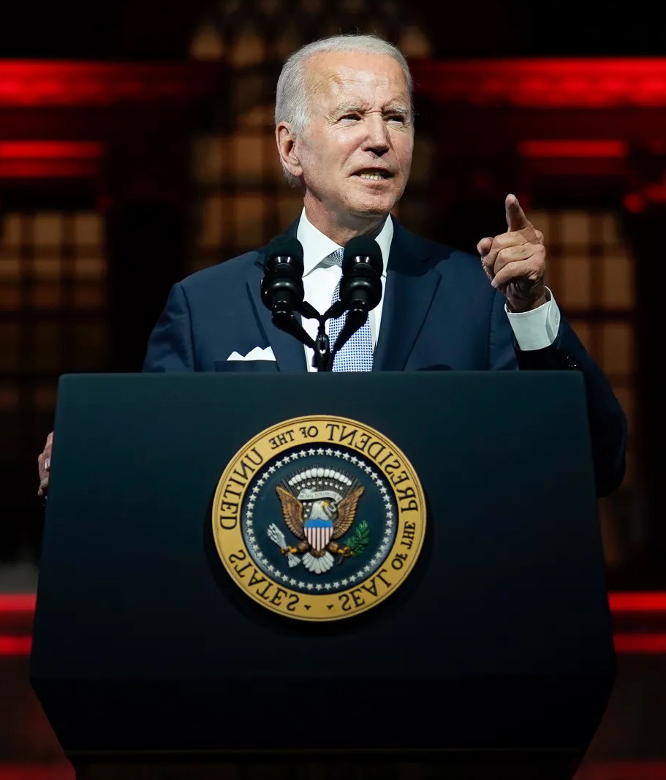
What Can We Do?
“Don’t tell me what you value, show me your budget and I’ll tell you what you value.”
Notes:
Donate today!
Transparent California is funded by individuals – the average donation to us is $48. Our staff makes very little, most donation money goes toward maintaining the site.
http://transparentcalifornia.com/donate
Make your own Public Record requests!
It’s not hard, anyone can do it. Keep your government on it’s toes by showing them you understand the power of real transparency!

Slide 16
Thanks!
Todd Maddison
Director of Research, Transparent California
todd@transparentcalifornia.com http://transparentcalifornia.com
Notes:
Thanks

