Slide 1
Budget 101
BUDGETING FOR SCHOOL BOARD MEMBERS
Whitney Marsh
Consultant, Education Policy and Budget
4 December, 2023

Slide 2
“Don’t tell me what your priorities are. Show me how you spend your money and I’ll tell you what they are.”
James W. Frick
2

Slide 3
AGENDA
State Education Budget
District Budget Process
Strategic Budgeting
3

Slide 4
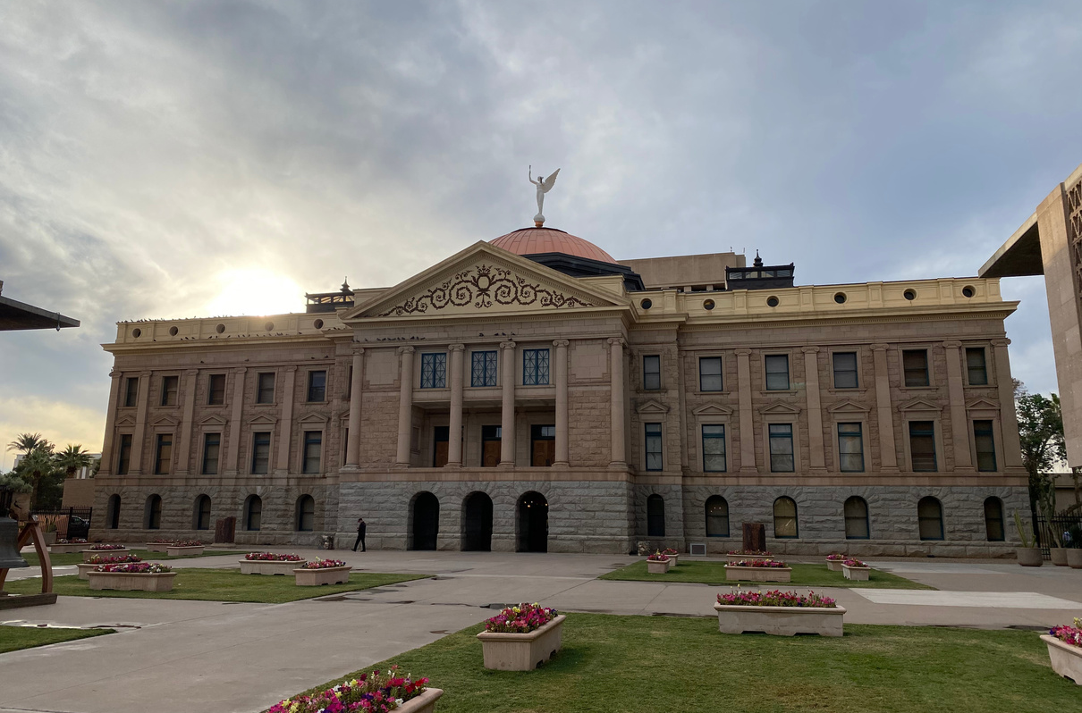
STATE BUDGET PROCESS
Annual budget process FY July 1 - June 30
State agencies prepare requests and submit to the Governor by Sept 1
Governor submits a budget proposal to the legislature in January
Legislative budget office produces baseline including ongoing costs and revenue projections
Legislature must act to revise specific portions of the K12 formula and may make other changes in the General Appropriations Act
Once approved by the legislature, the budget bill goes to the Governor for signature
4
Analytics-driven / User-friendly / Cloud-based
AI-powered / Scalable

Slide 5
BY THE NUMBERS
1.1 million
$16.5 billion
students
all funding
$9.7 billion
2k
formula funding
schools
58k
9 years
teachers
avg experience
$14.7k
76%
5
per student
hs grad rate

Slide 6
STATE FORMULA COMPONENTS
7.8B
Base Level
statutory amount
adjusted annually for inflation
applied to the weighted ADM
$4,915 in 2024
$7.8 B total
1.0B
Additional Assistance
statutory amount
applied to unweighted ADM
$550 - $ 733 in 2024
$1 B total
Transportation
213M
statutory amount
adjusted annually for inflation
applied to prior year route miles
$2.37 - $2.89 per mile
6

Slide 7
WEIGHTED STUDENT FUNDING
Student Enrollment is the Primary Determinant of State Formula Funding
Average Daily Membership (ADM): average enrollment for the first 100 days
ADM is weighted based on student and school characteristics
Group A weights are applied to all students based on grade level
Group B weights adjust for special populations (special ed, english learners, low-income)
7

Slide 8
NON-FORMULA REVENUE
M&O Overrides
Bonds
Federal Programs
M&O only
art music, PE, academic intervention
full day Kindergarten
Specific high priority capital projects
new construction
renovation
replacing buses
technology and computers
Targeted to specific student populations
restricted use
non-supplanting
8

Slide 9
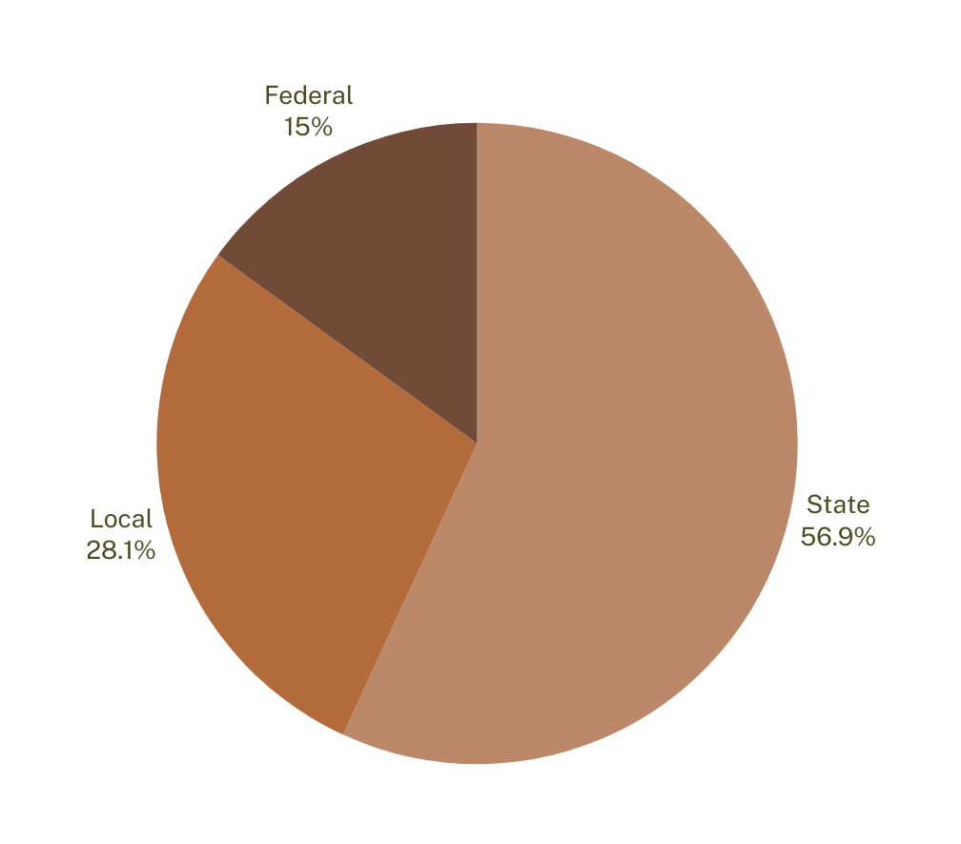
SOURCES OF FUNDS
9

Slide 10
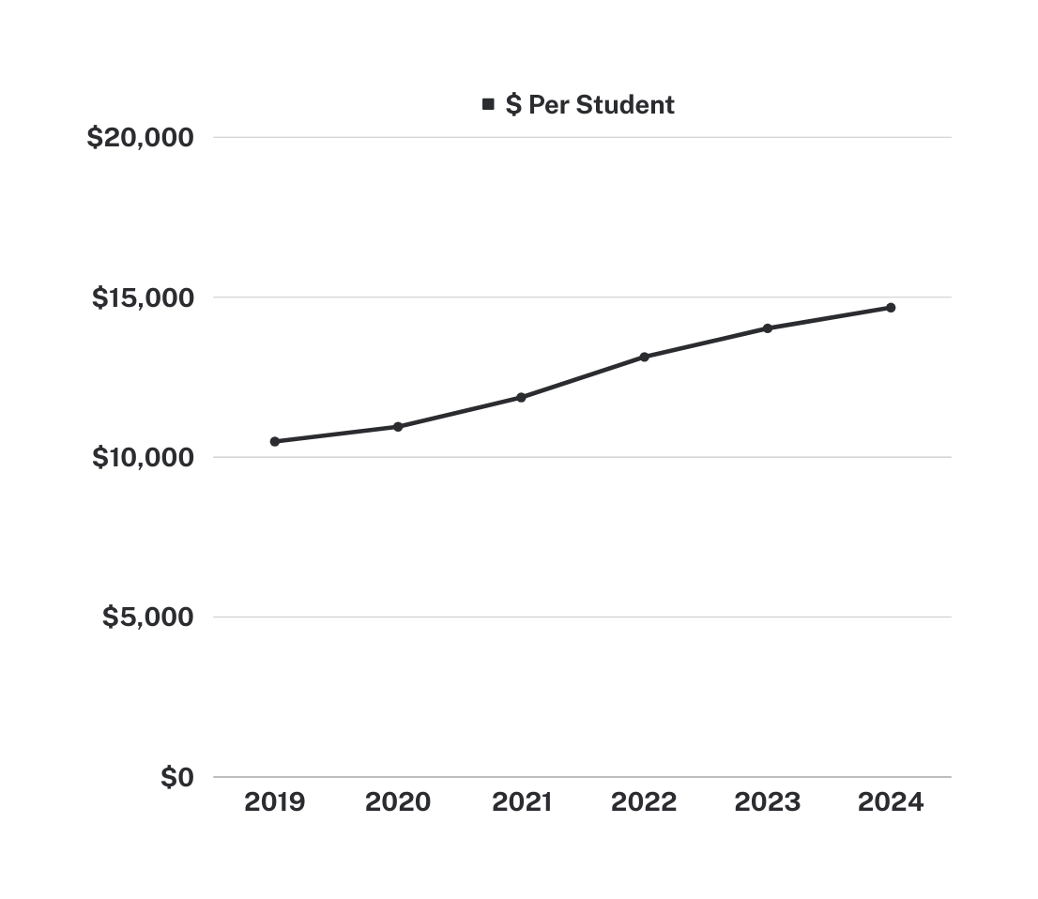
STATE TRENDS
10

Slide 11
DISRTICT BUDGET PROCESS
Engage
Plan
Budget
Adopt
Report
Q1
Q2
Q3
Q4
Q1
Get feedback from principals and families.
Provide specific means for school community to weigh in on district priorities
Review:
Current and prior year spending compared to projections
Current programs ROI
District priorities in strategic plan
Enrollment and revenue projections
Staffing and salary estimates
New programs and initiatives
Budget hearings
Adopted budget due to ADE July 15
Assess end of year data
Prepare annual reports for submission to ADE by October 15
11

Slide 12
DISTRICT BUDGETING
Centralized v. Decentralized Spending Models
Centralized determined at the district-level, based on ratios and allocation
Decentralized budget process give school leaders more input into the budget process
Strategy-driven / Student-centered / School-based
12

Slide 13
PRIMARY COMPONENTS OF SCHOOL BUDGETS
Classroom Spending
Administration
Facilties
Other
Curriculum and Instruction
Central Office
Plant Operations
Transportation and Food Service
Superintendents, principals, accounting, HR, governing board
Building maintenance, energy, groundskeeping, security
Teachers, instructional staff and support, student support, counselors, special education specialists, aids, athletics, librarians
Buses, gas, transporting students
Food supplies, transporting and serving meals
13

Slide 14
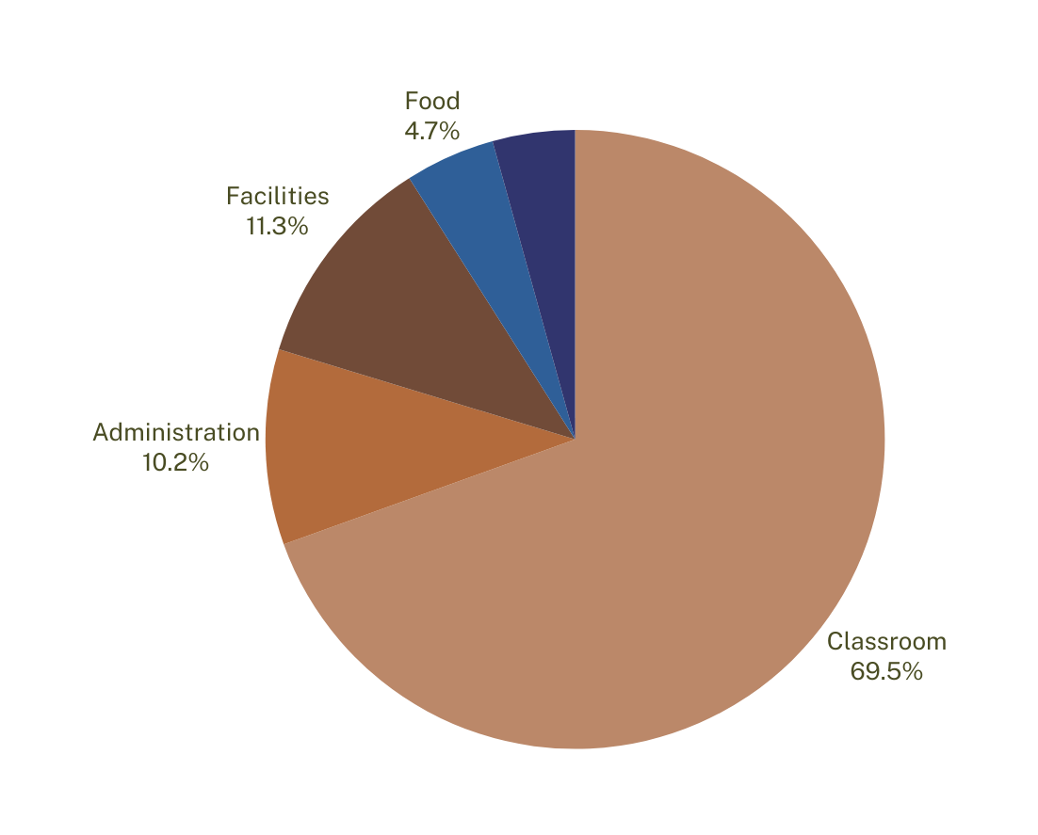
SPENDING BY CATEGORY
Transportation 4.3%
14

Slide 15
QUESTIONS TO ASK
What are school, district and state enrollment trends?
How accurate have our ADM projections been?
How does our property tax collections compare over 5 years?
What major facilities projects do we foresee?
How does our employee compensation compare?
What is our employee retention rate?
How does school-level spending compare within the district?
What is driving spending differences between schools?
What are the correlations between spending and student outcomes?
15

Slide 16
WHAT’S NEXT
Expiring COVID relief
Proposition 123
Aggregate expenditure limit
National enrollment declines
16

Slide 17
“There are no solutions, only trade offs.”
Economist Thomas Sowell
17

Slide 18
Thank you!
QUESTIONS
Whitney Marsh
Consultant, Education Policy and Budget
4 December, 2023

