Slide 1
Preparing the Next Generation: Improving Outcomes for All Students

Slide 2
Leadership ISD is an initiative of The Commit Partnership which is the largest collective impact education backbone in the United States. This is made possible by the school systems, higher education institutions, policymakers, businesses, and nonprofits who partner with us on behalf of the students they serve.

Slide 3
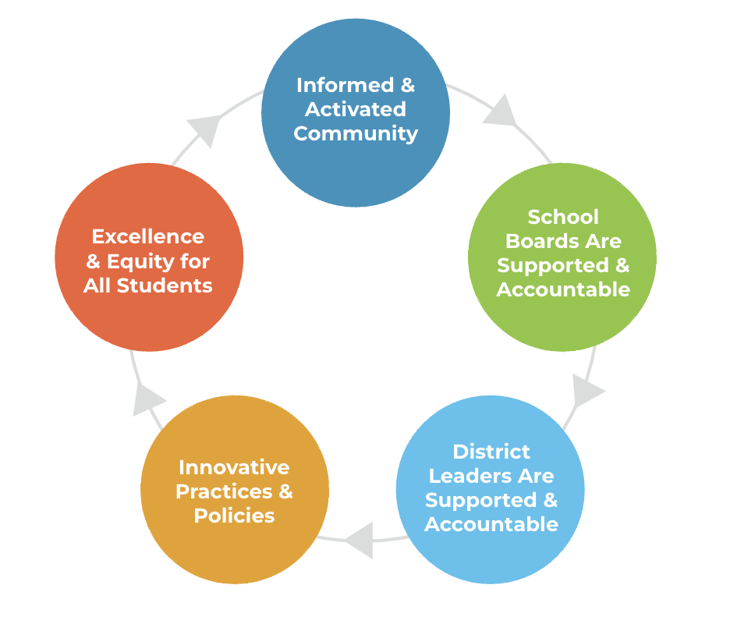
High quality board leadership is critical to the success of the organizations they are governing.
Transformation requires a cycle of shared vison and accountability

Slide 4
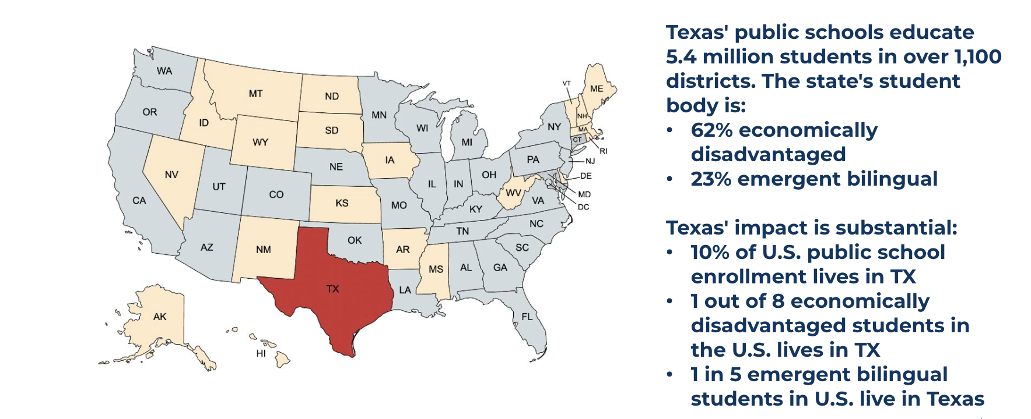
What happens in Texas matters greatly to the health of our nation Texas' PK-12 enrollment is larger than the combined enrollment of 20 different U.S. states

Slide 5
Texas has seen longitudinal improvement in student performance, but outcomes remain significantly below desired levels
Key Academic Milestones & Improvement from 2012 to 2023
2012 | 2023
2014 | 2023
2012 | 2024
2012 | 2024
2012 | 2024
2012 | 2024
2012 | 2023
2012 | 2023
2012 | 2023
2012 | 2023
Sources: TES TPEIR 2012 & 2023; TEA TAPR 2012 & 2023; TEA STAAR Aggregate 2012; TEA STAAR Preliminary 2024; College Ready per SAT/ACT; THECB 2012 & 2023

Slide 6
What is the most important component of a sandwich?

Slide 7
We Measure What We Value
Strong governance creates conditions to improve student outcomes by:
Creating clarity through the adoption of SMART student outcome goals and guardrails (vision and values)
Consistent and timely progress monitoring
Driving decision making
Resource allocation
Policy adoption
Superintendent evaluation
Creating an ecosystem of shared accountability

Slide 8
Incentivizing Adult Behavior
Student Outcome Goal - Outcomes that are a measure of what students know or are able to do.
Guardrails - A specific set of actions/way of doing things that is not allowed in pursuit of goals, because it violates the vision and values of the community. Our non-negotiables.
Policy - A deliberate system of guidelines that has been codified and adopted by the Board to guide decisions and achieve outcomes. A policy is a blueprint of the organizational activities which are repetitive/routine in nature. Resource Allocation - A budgetary and/or human capital decision to support policy or practice implementation
Superintendent Evaluation - A tool to measure and assess the performance of your Superintendent

Slide 9
Incentivizing Adult Behavior – Goals and Goal Progress Measures
Goal: Percentage of students at the Meets level on the 3rd grade STAAR math exam increases from 31.0% in May 2019 to 53.0% by May 2027.
GPM 1.1: The percentage of Pre‐K students that are On Track in Math Overall Measure on the MOY CLI assessment will increase from 91.0% in Oct. 2020 to 96.0% by May 2027.
GPM 1.2: The percentage of kindergarten students who score On Track on the Math Overall measure on the TX‐KEA MOY assessment will increase from 61.7% in Oct. 2020 to 79.0% in May 2027.
GPM 1.3 Student achievement for first-grade African American students scoring at or above grade level on a TEKS aligned assessment in reading shall increase from 29% to 37% by 2027.
GPM 1.4: The percent of 1st and 2nd graders at the 60th percentile or higher in math on the MAP assessment will increase from 28.5% in Sept. 2019 to 53.0% by May 2027.

Slide 10
Incentivizing Adult Behavior - Guardrails
Guardrail: The superintendent shall not allow the teacher turnover rate to exceed the state turnover rate.
PM 1.1: The teacher turnover rate in ISD will decrease from 14.7% to a rate at or below state turnover rate reported annually.
PM 1.2: Percent of staff responding positively to the overall quality of ISD will increase from 79% to 86% by 2025.
PM 1.3: Percent of staff indicating they have the necessary materials and resources they need to do their job will increase from 80% to 85% by 2025.

Slide 11
*The information contained in the goals and guardrails and their corresponding progress measures brings that data into view of the board. Whereas prior to their adoption, the administration did not necessarily need to report that information regularly.
Consistent, transparent, progress monitoring
creates shared accountability.

