Slide 1
Teacher Incentive Allotment Identifying & Compensating Highly Effective Teachers

Slide 2
Teacher Incentive Allotment (TIA) Overview
Purpose: Provide funding to school systems who redesign their teacher evaluation systems in a way that helps those systems:
Identify their most effective teachers based on quantitative student growth data and,
Compensate effective teachers significantly more.
Nuts & Bolts:
Optional program with wide flexibility for districts to design in a way that best meets their needs.
A qualified TIA system must include, at minimum, the following components:
Principal evaluation (T-TESS or other)
Student academic growth measure(s)
Teachers designated by a TIA system receive one of three designations: Recognized, Exemplary, or Master
Funding earned depends on designation level, concentration of poverty at that campus, and whether campus is rural
90% of funding earned by school systems must go directly to educator salaries on the designated teacher’s campus
Designated teachers earn funding for five years

Slide 3
Designing, Implementing and Receiving Full Approval on a TIA System will take approximately 2 years
Design Year
Data Capture Year
Full Approval
2024 – 25 SY
2025 – 26 SY
2026 – 27 SY
District works with stakeholders to design TIA system
Determine:
Teacher eligibility
Metrics
Weights
Funding plan
Implement Plan as Approved
Collect Performance Data
Conduct Teacher Survey
Fall 2026
Submit Data for Validation by TTU
Summer 2025
Receive System Approval
Spring 2027
Receive Full Approval
Summer 2026
Analyze Data
Identify Designated Teachers
April 2025
Submit Plan to TEA
Source: tiatexas.org Funding Map

Slide 4
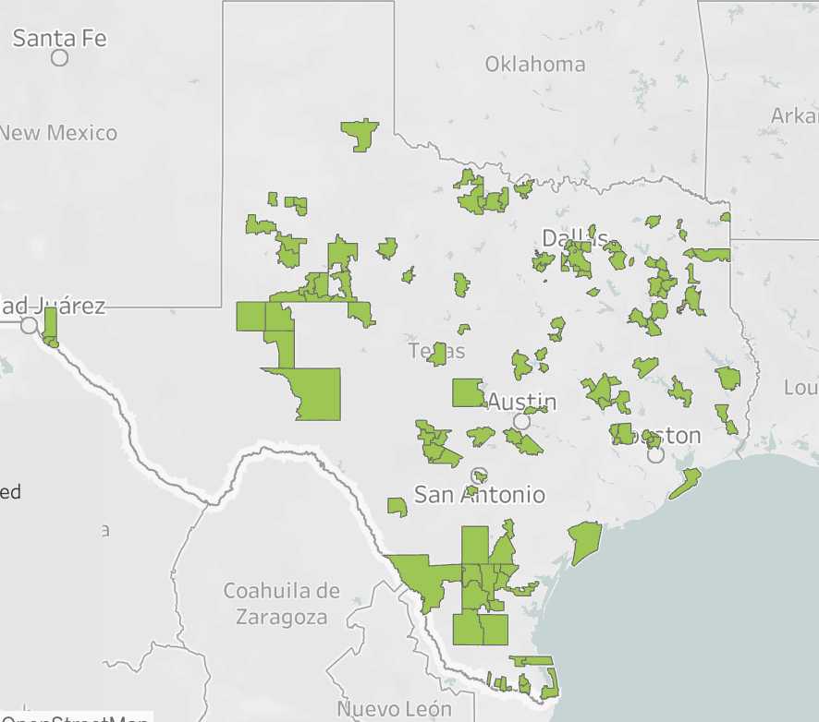
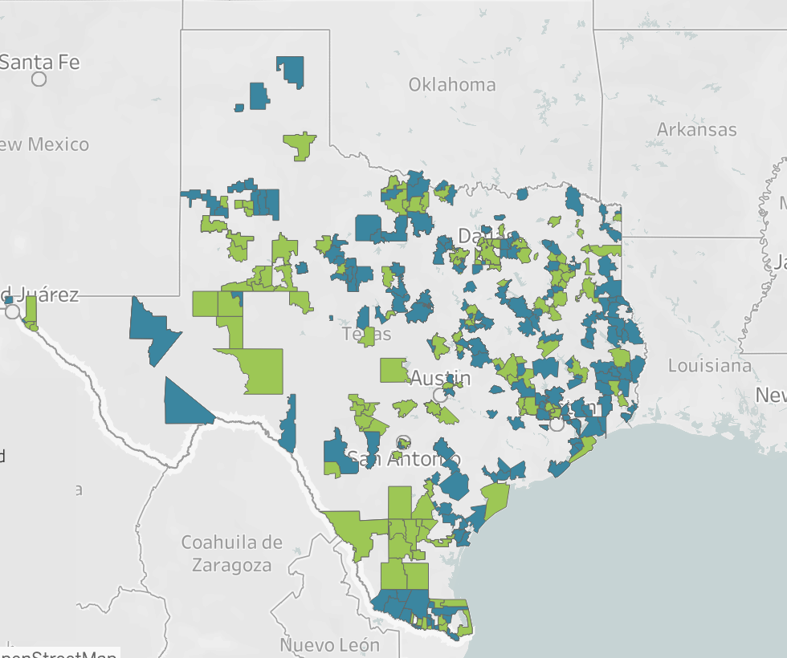
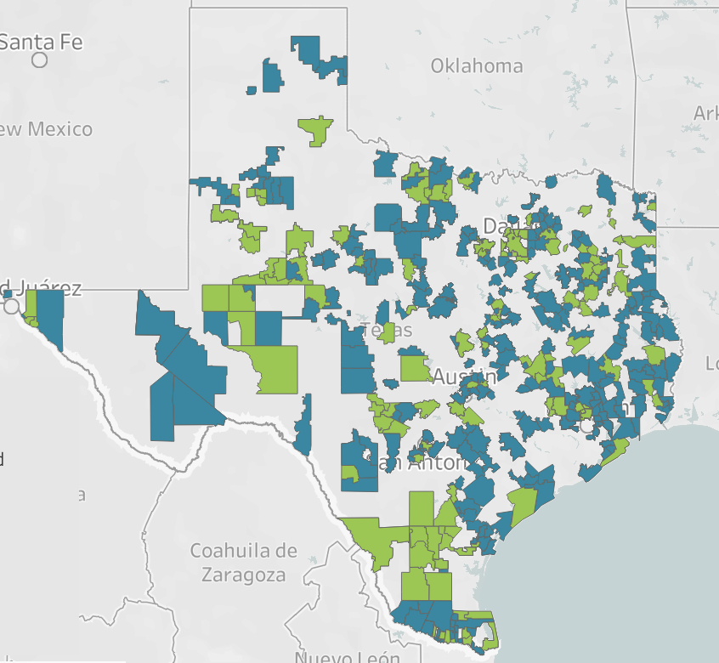
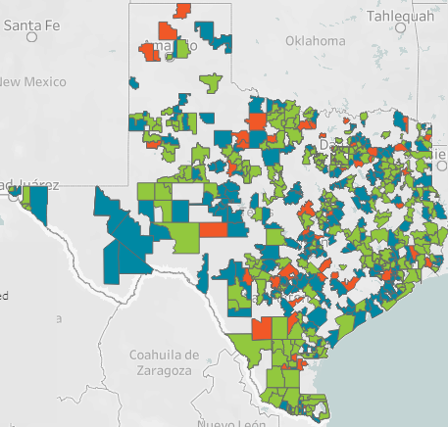
Teacher Incentive Allotment’s (TIA) explosive growth provides an example of the impact of policy implementation
Cohorts A - D
Cohorts A - E
Cohorts A - F
Cohorts A - G
Systems: 173
Students: 1.4 Million
Systems: 377
Students: 2.5 Million
Systems: 481
Students: 3.1 Million
Systems: 599
Students: 3.7 Million
Over the past three years, Texas Impact Network has supported 96 school systems serving 1.2MM students (24% of Texas students).
Notes:
We are here to connect you to resources (and one another)

Slide 5
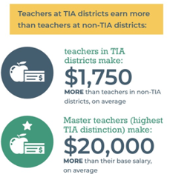
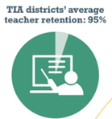
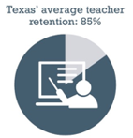
Teacher Incentive Allotment (TIA) is beginning to show significant positive impacts in school systems across Texas
Compensation
Equity
Average teacher retention rate in FY21 to FY22 school year is higher at TIA districts
Teachers at TIA districts earn more than teachers at non-TIA districts
Teachers at TIA districts serve on campuses with higher concentrations of poverty
2x
Campuses with TIA designated teachers serve twice the rate of students from economically challenged neighborhoods – suggesting that TIA teachers are serving on campuses where they are needed most.
Source: Texas Impact Network 2023 Annual Report

Slide 6
Case Study: Dallas ISD

Slide 7
Proficient I and Higher Teachers are retained in the district at rates
above 90% in all years of implementation.
October 2023
Proficient I+
TEI-eligible teachers retained in District, October to October annually. Teachers who have not received an effectiveness level are not included.
52% of Unsatisfactory Teachers retained in 2022-23.
6
Notes:
TEI and TIA data, of course, gives us so much information to support our teachers – and one of those key pieces of information is on teacher retention.
We hear our teachers’ feedback and recognize that compensation cannot be the sole strategy for retention, however, data shows us the hitting Proficient I under TEI is the leading indicator that our teachers will be retained in the district over time. Notably, retention of TEI-Distinguished and TIA designated teachers at our about 92% annually.

Slide 8
In 2022, Dallas ISD had lower teacher turnover than the state and most surrounding school districts, reversing the trend from the past decade.
Dallas ISD Teacher Turnover vs State and Region (2012 to 2022)
While teacher turnover has increased, Dallas ISD turnover is now 1.3% lower than the state and 3.6% lower than Region 10 districts despite reflecting a
much higher percentage of high poverty campuses.
2023-24 comparison data available in December 2024
TEI Implemented
Fall 2014
Teacher Turnover measured annually using TAPR methodology for 087 positions.
*2023-24 data will be available in December 2024 TPRS reports
7
Notes:
While differential retention remains a strength of the TIA/TEI data, we can also compare overall teacher turnover against the state and peers. In 2022, Dallas ISD had lower teacher turnover than the state and most surrounding school districts, reversing the trend from the past decade. Despite having a much higher percentage of economically disadvantaged students, Dallas ISD teacher attrition was 1.3 percentage points lower than the state and nearly 4 percentage points lower than Region 10.
It is important to note that the state’s methodology includes in the turnover (“attrition”) rate teachers who remain employed in the District but transition to non-teaching positions, such as counselors, reset coordinators, media specialists, or campus leaders. This accounts for up to 3.0% of teacher turnover annually.

